Slide 1
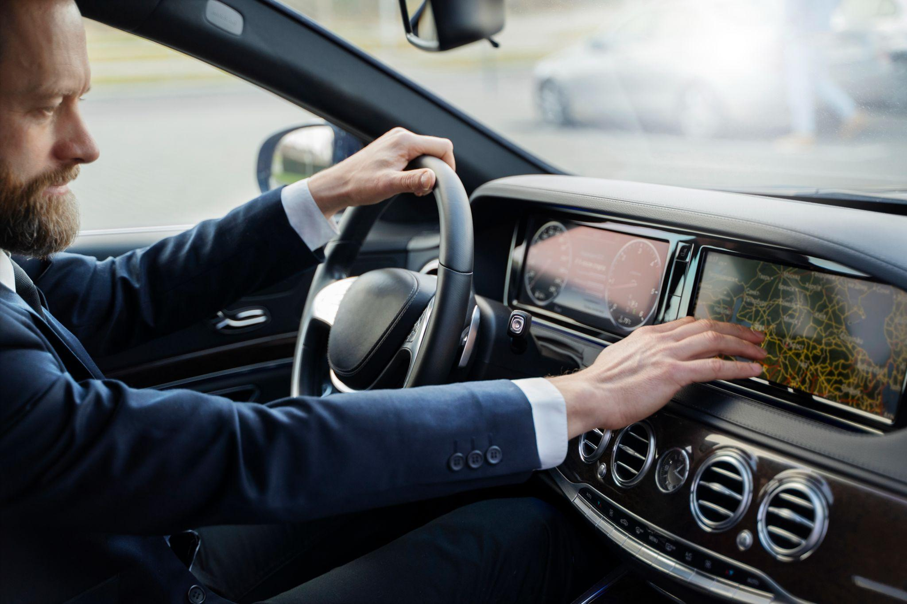
Automotive Ecommerce
"Driving Your Dreams, One Click at a Time"

Slide 2
Project Supervisor: Mr. Ubaid Aftab Chawala
Group Members
Ishaqullah Siddiqui (20k-0148)
Muhib Ahmed (20k-0405)
Sarim Latif Khan (20k-1644)

Slide 3
Contents
Introduction
Problem Statement
Solution Overview
Literature Review
Key Features
Context Diagram
Benefits
Technoligies
Market Survey

Slide 4
Introduction
We are thrilled to present AutoConnect, our groundbreaking e-commerce platform for vehicles. AutoConnect is not just a platform; it's a revolution in vehicle commerce that combines innovation and convenience.

Slide 5
Problem Statement
Buying and selling vehicles has been plagued by challenges:
Complex Car Transactions: Car buyers and sellers face complex decisions, from choosing the right vehicle to negotiating prices and assessing vehicle history.
Information Overload: The abundance of online car information can overwhelm users, making informed decisions difficult.
Trust Concerns: Trust issues often arise between buyers and sellers due to doubts about .

Slide 6
Solution Overview
AutoConnect is the solution to these problems, offering:
Simplified Decision-Making: Our web app streamlines car transactions with an intuitive interface, simplifying choices for users.
Data Intelligence: We aggregate and analyze data to provide users with accurate information, including vehicle history reports and market trends.
Negotiation Assistance: Our chatbot aids users in fair and beneficial deals by offering insights and suggestions during negotiations.
Trust & Transparency: User-generated reviews and ratings enhance trust, while real-time messaging fosters transparent communication.
Personalized Recommendations: Our AI recommendation engine suggests vehicles based on user preferences, streamlining the search process.

Slide 7
Literature Review
Online car marketplaces are essential in the automotive industry, providing a digital space for buyers and sellers. Platforms like PakWheels and CarFirst are known for their extensive listings and user-friendly interfaces, simplifying car purchases and enabling easy price and feature comparisons. However, these platforms often use static listings and basic communication tools, leaving room for innovation to enhance the user experience and streamline transactions.
Features | PakWheels | CarFirst | Gaari.pk
Vehicle Listings | ✓ | ✓ | ✓
Selling/Buying Cars | ✓ | ✓ | ✓
Price Calculator | ✓ | ✕ | ✓
Automotive News and Blog | ✓ | ✓ | ✓
User Reviews | ✓ | ✓ | ✓
Hassle-Free Documentation | ✕ | ✓ | ✕
Customer Support | ✕ | ✓ | ✕
Advanced Search Filters | ✓ | ✓ | ✓

Slide 8
Negotiation ChatBot In Automotive E-Commerce
Chatbots in e-commerce are valued for enhancing customer interactions. While they've been used in online car sales for inquiries, our project aims to introduce a negotiation chatbot for smoother transactions, filling a gap in this area. This chatbot will actively engage with buyers, negotiate for sellers, and improve the overall car buying experience.

Slide 9
Key Features
1. Smart Negotiation Bot: Say goodbye to haggling. Our bot ensures fair deals.
2. Live Video Calling: Expert-guided vehicle inspections in real-time.
3. Comprehensive Listings: A wide variety of vehicles for every preference.
4. Personalized User Accounts: Tailor your journey.
5. Diverse Portals: Connecting users, mechanics, and enthusiasts.
6. Effortless Vehicle Comparison: Make informed decisions effortlessly.
7. Advanced Search and Filters: Find the exact vehicle you desire.
8. Empowering User Reviews: Contribute to an informed community.
9. Real-time Communication: Swift and effective interactions.
10. Insightful Vehicle History: Transparency through trusted APIs.
11. Expert Customer Support: Instant resolution for a smooth experience.
12. AI-Driven Recommendations: Your personalized vehicle suggestions.

Slide 10
Context Diagram

Slide 11
Waterfall management plan
Requirements
Design
Implementation
Verification
Maintenance

Slide 12
Benefits
1. Streamlined Car Transactions:
"Say goodbye to the hassle! Our app simplifies car buying and selling, making it as easy as a few clicks."
2. Negotiation Assistance:
"Negotiate like a pro! Our chatbot helps you get the best deal, putting you in the driver's seat."
3. Real-Time Video Calls:
"See it, believe it! Conduct video calls with the seller, buyer, and even a mechanic for complete transparency."
4. Tailored Recommendations:
"Find your dream ride! Our AI learns your preferences and recommends cars that match your style."
5. Secure Payments:
"Safe and sound! We integrate top-notch payment gateways to ensure secure transactions."
6. Extensive Search and Filters:
"Your perfect match is waiting! Use powerful search and filtering options to find the ideal vehicle."

Slide 13
7. User Reviews and Ratings:
"Trust the community! Read user reviews and ratings to make informed decisions."
8. Instant Messaging and Notifications:
"Stay connected! Our real-time messaging and notifications keep you updated on your car journey."
9. Mobile Responsiveness:
- "On the move? No problem! Our app adapts seamlessly to your device, giving you the best experience."
10. Outstanding Customer Support:
- "We've got your back! Enjoy excellent customer support with our live chat and assistance tools."
11. Revolutionize Negotiations:
- "Empower yourself! We're changing the game with AI-powered negotiations."
12. Modern, Intuitive UI:
- "Beauty and brains! Our app combines stunning design with effortless usability."

Slide 14
Tech Stack

Slide 15
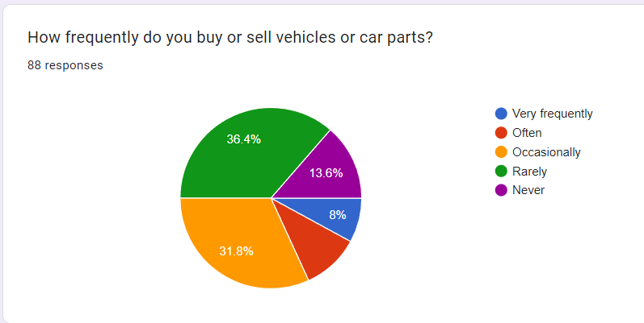
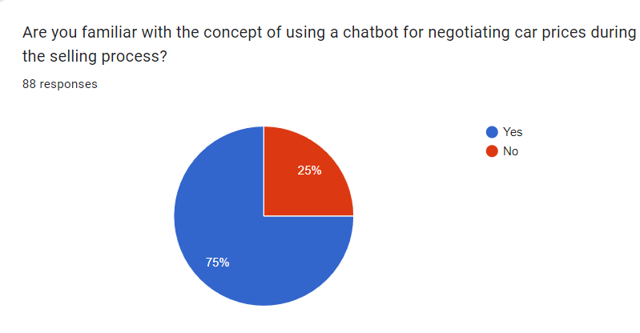
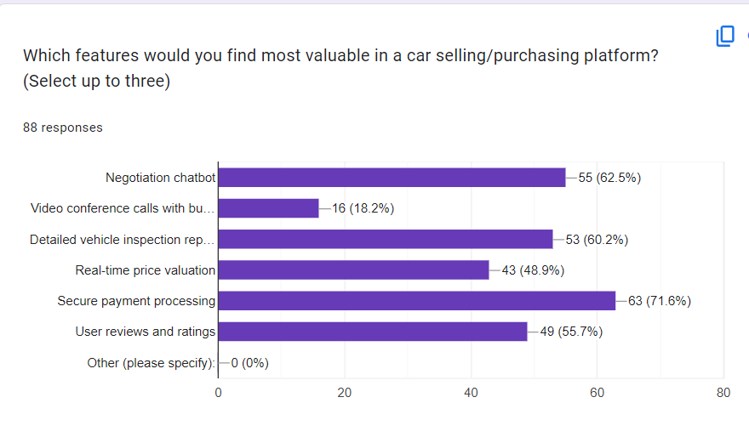
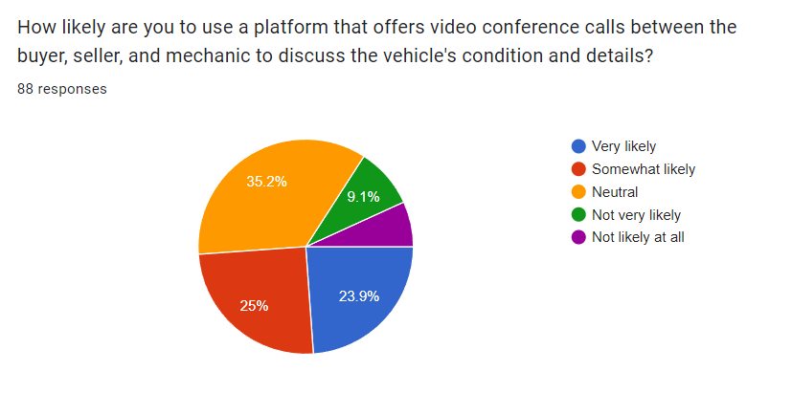
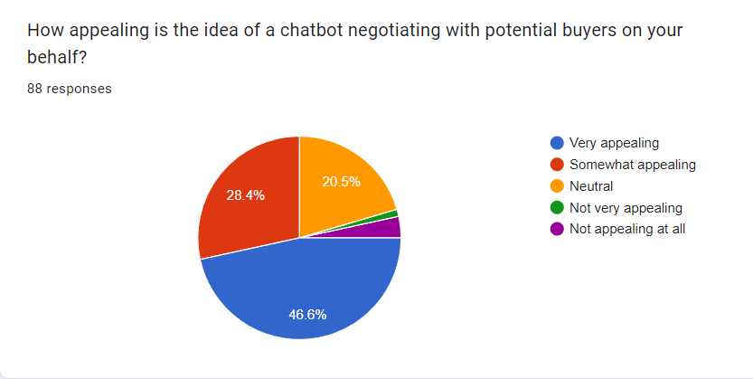
Market Survey

